Slide 1
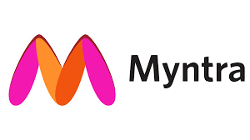
Myntra Analysis
Ramya Raghavan
MB28
Capstone Project - II

Slide 2
Company overview
Name: Myntra
Founded: 2007-2008 (initially for personalized gifts), transitioned to fashion and lifestyle in 2011
Headquarters: Bengaluru, Karnataka
Acquisition History: Acquired by Flipkart in 2014,Became part of the Walmart Group in 2018
Product Range: Myntra offers a diverse array of fashion and lifestyle products including apparel, accessories,
cosmetics, and footwear.
Brands: The company carries over 6,000 brands, including major international and domestic names such as Adidas,
Nike, Puma, H&M, and Levi's.
Services:
Loyalty Program: Encourages repeat purchases and enhances customer retention.
Deals and Offers: Includes promotions and discounts to attract and retain customers.
Customer Support: 24/7 customer connect team ensures support availability around the clock.
Express Delivery Service: Launched in May 2022, the "M-express tag" offers expedited delivery within 24–48 hours,
catering to the growing demand for faster service.

Slide 3
Market Position and strategy
Acquisition and Integration: Myntra's acquisition by Flipkart and subsequent inclusion in the Walmart Group
expands its reach and resources. Integration with these larger entities provides strategic advantages, including
enhanced logistics, technology, and market reach.
Product and Brand Diversity: By offering products from over 6,000 brands, Myntra positions itself as a
comprehensive fashion and lifestyle destination, appealing to a broad consumer base.
Technological and Logistics Investment: The express delivery service reflects an investment in logistics and
technology to improve customer satisfaction and competitiveness in a fast-paced market.
Brand Portfolio : A wide of brands and products attracts diverse customer segments.
Customer Experience : The loyalty program and robust customer support contribute to higher customer satisfaction
and retention.
Speed of Service : The express delivery initiative caters to the increasing consumer demand for faster delivery times,
positioning Myntra as a leader in operational efficiency within the e-commerce sector.

Slide 4
Challenges and opportunities
Challenges:
Intense Competition: Facing competition from other e-commerce giants and fashion retailers.
Logistics Management: Ensuring timely delivery while managing a vast product range and customer base.
Opportunities:
Market Expansion: Potential for growth in new markets and segments.
Technological Advancements: Leveraging technology to enhance customer experience and streamline
operations.
Personalization: Further development of personalized services and products could drive additional customer
engagement.
Overall, Myntra's strategic positioning within the Indian e-commerce market, backed by significant corporate
acquisitions and investments in logistics and customer service, provides a strong foundation for continued growth
and competitive advantage.

Slide 5
STP Analysis
Segmentation
Myntra focuses on Fashion-conscious customers who believe in shopping from home irrespective of age and gender.
Target Market
The Target Market set by this brand is Fashion conscious ,medium income ,young online shoppers looking for the best deals and good quality products.
Positioning
Myntra is an e-commerce website that focuses on creating vibrant fashion stores at affordable rates all over India

Slide 6
Key channels & Strategies
Direct via website
Direct via mobile application
Direct via affiliate networks
SEO Strategy
Influencer Marketing
Content Marketing Strategy

Slide 7
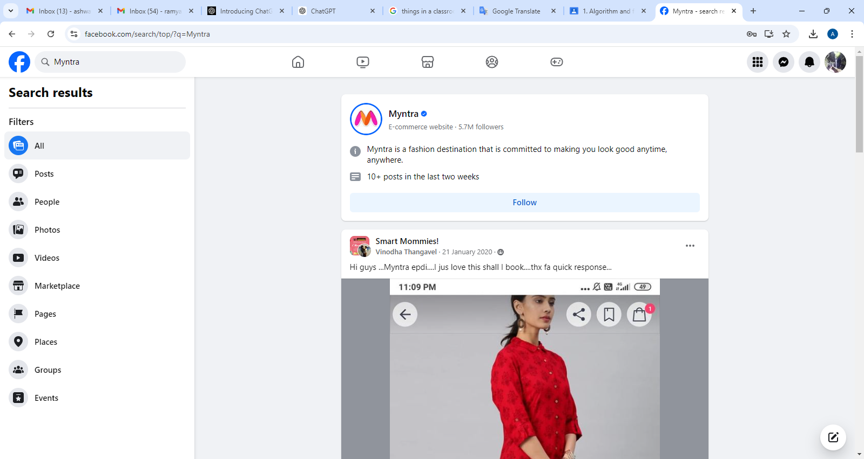
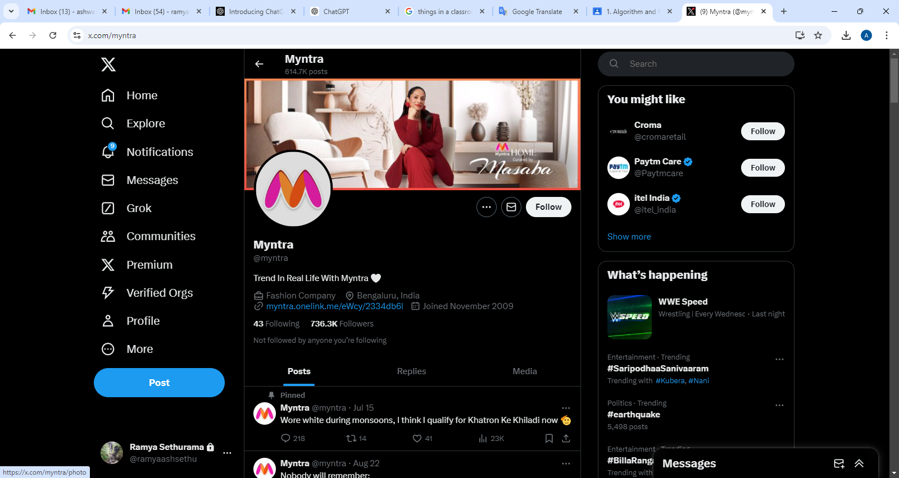
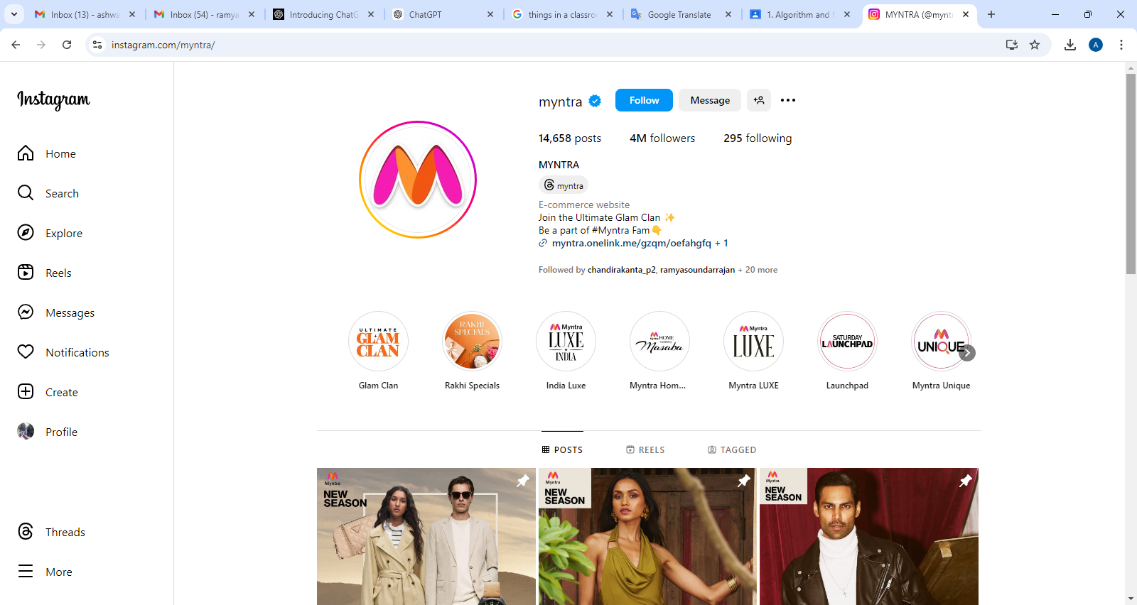
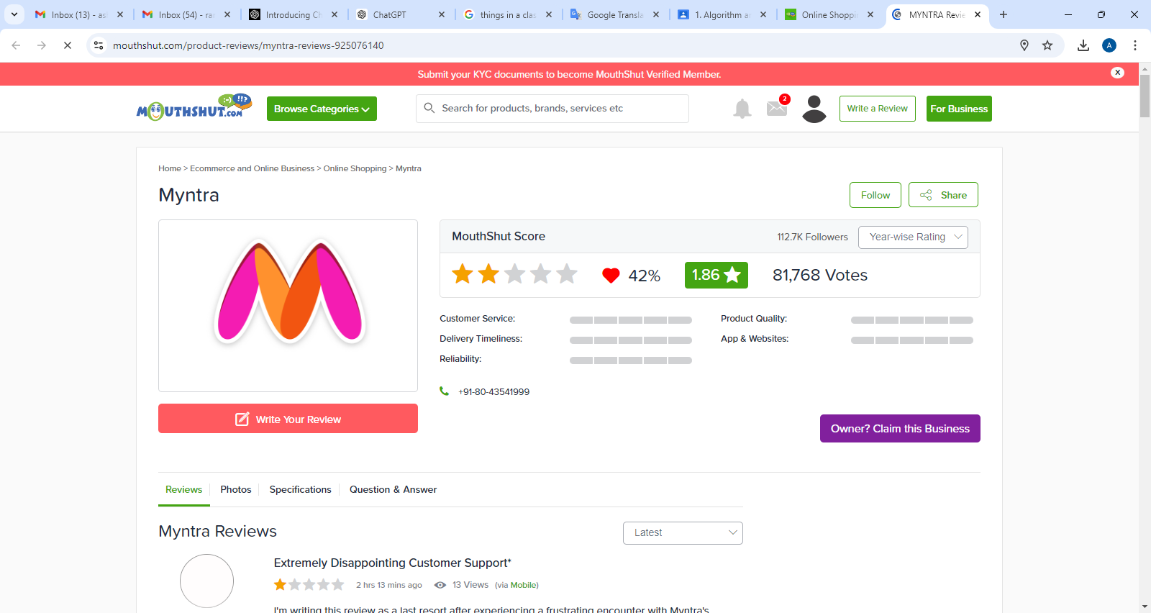
Social Media Handles and #
#Myntra,#MyntraFashion,#MyntraStyle,#MyntraBeauty,#MyntraEndOfReasonSale,#MyntraFlashSale,#MyntraBigFashionFestival ,#MyntraEssentials,#MyntraTrendy,#MyntraMoments,#FestiveFashion,#SummerFashion,#FestiveFashion ,#StyleInspo,#FashionDeals

Slide 8
Social Media Reviews
Aspect | Positive points | Negative Points | Neutral Points | Business Impact
Product Quality | High-quality materials and craftsmanship. Fashionable and durable products. | Issues with defects. Discrepancies between online images and actual products. Sizing issues. | N/A | Strength: Enhances customer satisfaction with quality products. Weakness: Defects and sizing issues may impact customer trust.
Variety and Selection | Extensive range of products and brands. Exclusive collections and designer collaborations. | N/A | N/A | Strength: Broad selection attracts diverse customer base. Opportunity: Can further expand range to capture more market segments.
User Experience | Intuitive website/app design. Easy navigation and smooth checkout process. | Occasional technical issues. Some usability challenges. | Mixed feedback on site performance. | Strength: Positive user experience drives customer satisfaction. Weakness: Technical issues can lead to frustration and affect conversion rates.
Customer Service | Responsive and helpful support. Effective issue resolution. | Slow response times. Reports of unhelpful interactions. | N/A | Strength: Effective service enhances customer loyalty. Weakness: Poor service can lead to dissatisfaction and loss of customers.
Delivery Experience | Timely deliveries. Good packaging. Efficient order tracking. | Frequent delays. Inaccurate delivery times | Shipping costs comments. | Strength: Timely delivery and packaging enhance customer experience. Weakness: Delivery delays impact customer satisfaction.
Pricing and Discounts | Competitive pricing. Attractive discount offers. | Issues with discount applications. Perceived lack of value for money. | General opinions on overall value. | Strength: Competitive pricing and discounts drive sales. Weakness: Pricing issues may affect customer perception and retention.
Return and Exchange | N/A | Complicated return procedures. Delays in processing returns and refunds. | N/A | Weakness: Complex return process can deter customers and increase dissatisfaction.
Product Availability | N/A | N/A | Mixed comments on stock levels. | Opportunity: Improve inventory management to address stock availability issues and enhance customer satisfaction.

Slide 9
Common descriptors & Sentiments
Trendy
Fashionable
Diverse
Stylish
Convenient
Discounts
Exclusive
Quality
Innovative
Customer-focused
Sentiments
Positive
Satisfaction
Appreciation for deals
Quality
Neutral
Average Experience
Negative
Customer Service issues
Quality concerns
Delivery Problems

Slide 10
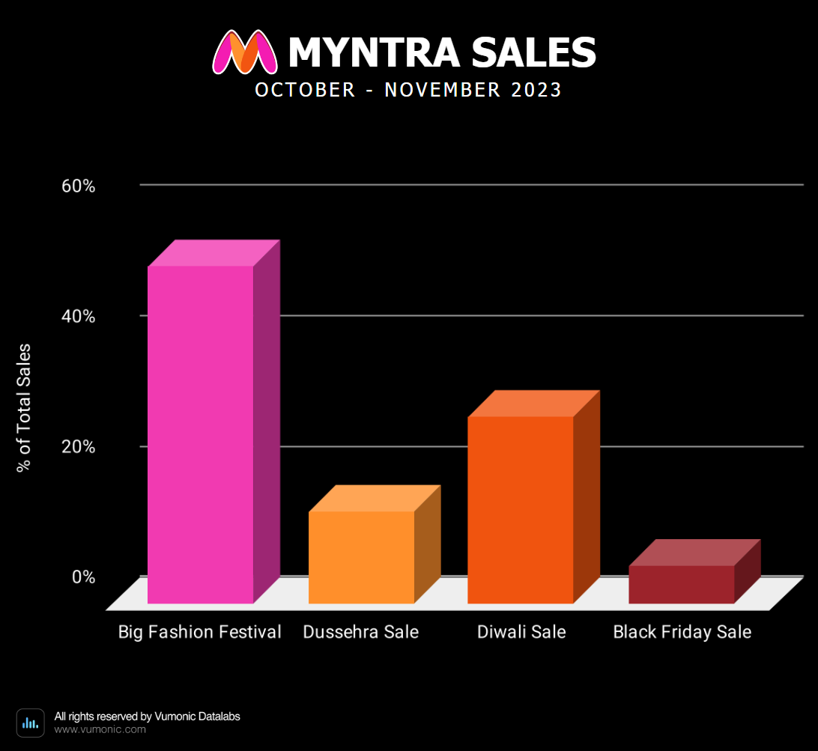
Myntra sales 2023 during festive season
Brand Positioning: Successful sales events contributed to enhanced brand visibility and market positioning.
Customer Loyalty:
Competitive discounts and festive offers improved customer retention and loyalty.
Market Share:
Sales events allowed Myntra to expand its market share, especially in categories like ethnic wear, electronics, and global fashion.

Slide 11
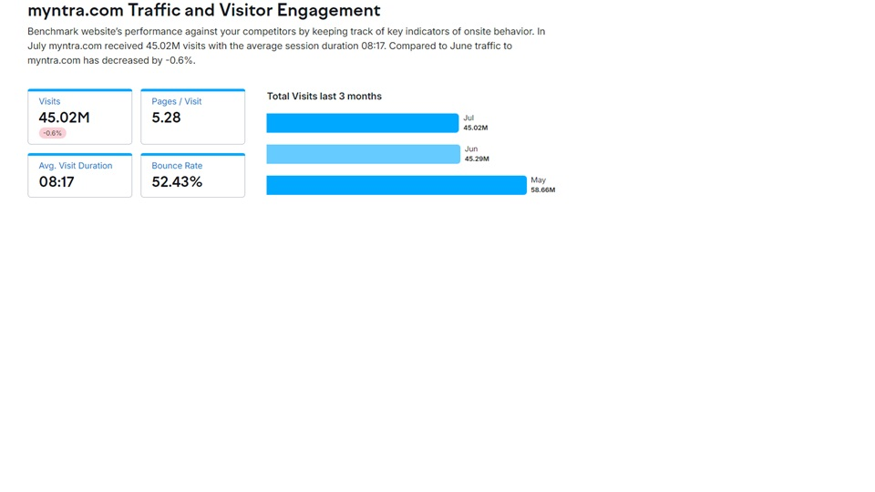
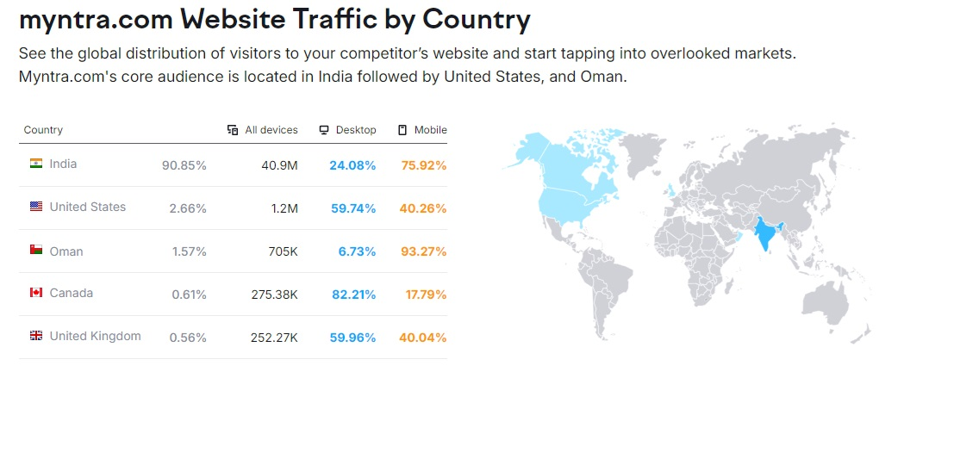
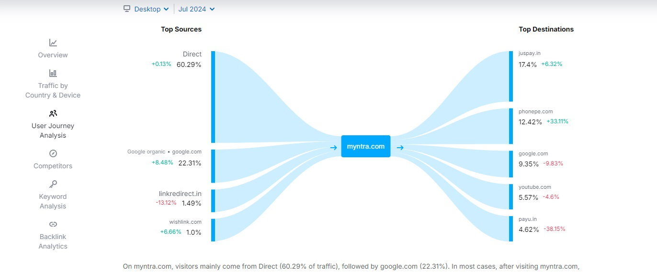
Statistical data from SEMRUSH

Slide 12
Emerging fashion trends and popular styles
Sustainable Fashion | Bold Colours and Patterns | Gender Fluidity | Tech-infused fashion | Retro Revival | Tailoring twist | Maximalism | Comfort and Practicality | Cultural Influences
What: Clothing made from eco-friendly materials and produced using ethical practices. | What: Bright, eye-catching colors and unique designs are becoming popular. | What: Clothing designed to be worn by anyone, regardless of gender. | What: Clothing with integrated technology, like smart fabrics or wearable gadgets. | What: Styles from past decades, especially the '90s and early 2000s, are making a comeback. | What: Traditional tailored clothing with modern, unconventional elements. | What: A trend towards bold, layered outfits with mixed patterns and textures. | What: Emphasis on comfortable and functional clothing, like oversized sweaters and casual wear. | What: Incorporation of global cultural elements and traditional techniques into modern fashion.
Why: Growing consumer demand for environmentally friendly products and transparency. | Why: Consumers seek to stand out and express their individuality. | Why: Increasing acceptance of diverse gender identities and expressions | Why: Innovation and the growing interest in tech-enhanced lifestyles. | Why: Nostalgia and the cyclical nature of fashion trends. | Why: Desire for a mix of professionalism and casual comfort. | Why: A reaction against minimalism and a push for more expressive, personalized fashion. | Why: Increased focus on daily wear and lifestyle changes. | Why: Growing appreciation for cultural diversity and authenticity
Opportunity: Brands can capture market share by adopting green practices and marketing their sustainability efforts. | Opportunity: Retailers can introduce vibrant collections and limited-edition pieces to attract trend-conscious customers. | Opportunity: Companies can expand their market by offering unisex lines and promoting inclusivity. | Opportunity: Fashion brands can differentiate themselves by incorporating technology into their products. | Opportunity: Brands can capitalize on nostalgia by reintroducing classic designs and styles. | Opportunity: Offering innovative tailoring options can appeal to consumers seeking a blend of formal and relaxed styles. | Opportunity: Retailers can attract customers by showcasing eclectic and elaborate designs. | Opportunity: Brands can succeed by offering practical, stylish options for everyday use. | Opportunity: Companies can enhance their appeal by embracing and celebrating cultural elements in their designs.

Slide 13
Fashion conversation post and the impact
Posttype | Busniess Impact | Engagement Metrics | Sales impact | Brand Awareness
Outfit inspiration | High | High | Medium | High
Fashion week coverage | High | Medium | High | High
Brand Collaborations | Very high | High | Very High | Very High
Style Challenges | Medium | High | Medium | Medium
Trend Forecasts | High | Medium | Medium | High
Sustainable Fashion | High | Medium | Medium | High
Fashion hacks and tips | Medium | High | Low | Medium
Celebrity Endorsements | Very High | Very High | Very High | Very High
Unboxing and Reviews | High | High | High | Medium

Slide 14
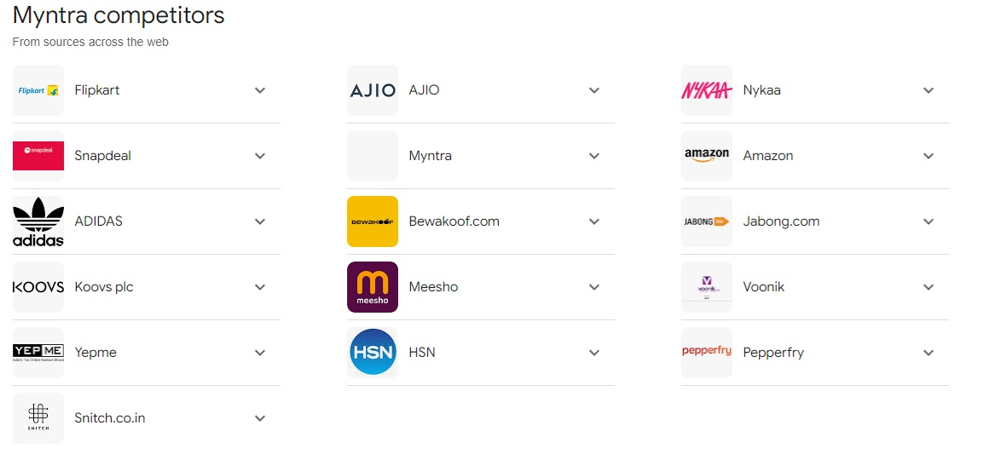
Competitors

Slide 15
comparative table summarizing Myntra, Amazon fashion, Flipkart, and Ajio across key metrics:
Criteria | Myntra | Amazon fashion | Flipkart | Ajio
Product Range | Focus on fashion and lifestyle. Wide range of apparel, footwear, accessories, and beauty products. | Broad range including various fashion categories and brands; integrates with Amazon's overall ecosystem. | Diverse product range including fashion, electronics, home goods, and more. | Focus on fashion and lifestyle with curated collections and exclusive brands.
Pricing Strategy | Mid-range to premium; frequent sales and discounts. | Competitive pricing across various fashion categories; frequent deals and discounts. | Competitive pricing with a focus on value-for-money; frequent sales events. | Mid-range pricing with significant discounts on fashion items.
Customer Satisfaction | Generally high for fashion items; issues with delivery times and order accuracy. | High satisfaction due to wide range, reliable delivery, and robust customer service. | Good satisfaction; similar issues with third-party sellers affecting product quality. | Positive feedback for fashion selections and return policies; issues with delivery times.
Social media Presence | Active on Instagram, Facebook, and Twitter; focuses on fashion trends and influencer collaborations. | Strong presence on Facebook, Twitter, Instagram, and LinkedIn; diverse content. | Active on Facebook, Twitter, Instagram, and YouTube; focuses on promotions and product highlights. | Active on Instagram, Facebook, and Twitter; emphasizes fashion trends and exclusive collections.

Slide 16
Key Insights
Product Range :
Amazon fashion and Flipkart offer extensive variety, while Myntra and Ajio specialize in Fashion
Pricing Strategy :
Amazon fashion and Flipkart use competitive pricing strategies, while Myntra and Ajio target fashion-specific pricing.
Customer Satisfaction:
All platforms show strengths, with Myntra and Ajio excelling in fashion, and Amazon and Flipkart maintaining high standards across broader categories.
Social Media Presence :
All four platforms leverage social media effectively, with Myntra and Ajio focusing on fashion content and Amazon and Flipkart adopting broader engagement strategies.

Slide 17
Strength and weakness
Myntra:
Strengths: Fashion-focused social media content, positive fashion reviews, strong influencer engagement.
Weaknesses: Limited product range, delivery issues, and pricing concerns.
Amazon Fashion:
Strengths: Broad social media reach, extensive and reliable reviews, wide product variety.
Weaknesses: Generic content approach, third-party seller variability, and review management challenges.
Ajio:
Strengths: Trendy and fashion-focused social media, positive fashion feedback, exclusive collections.
Weaknesses: Limited social media reach, occasional delivery issues, and order accuracy concerns.
Flipkart:
Strengths: Broad social media presence, effective promotions, good service infrastructure.
Weaknesses: Diluted fashion focus, inconsistent engagement, and third-party seller issues.

Slide 18
Myntra’s competitiveness
Myntra’s Competitive Advantages:
Fashion Expertise: Specializes in fashion with a curated selection and deep industry knowledge.
Exclusive Collections: Offers unique and exclusive fashion items through strong brand partnerships.
Myntra’s Competitive Disadvantages:
Limited Product Range: Focuses solely on fashion, lacking the broader product diversity of Amazon Fashion and Flipkart.
Pricing and Promotions: Less competitive pricing compared to Flipkart, and limited integration advantages compared to Amazon’s ecosystem.
These insights outline Myntra's strategic positioning and competitive landscape, highlighting areas where it excels and identifying challenges relative to Amazon Fashion, Flipkart, and Ajio.

Slide 19
Strategic recommendations
Customer Satisfaction:
Actions: Leverage data to enhance customer service, optimize delivery logistics, personalize shopping
experiences, and improve return policies.
Impact: Increases customer satisfaction and loyalty.
Product Offerings:
Actions: Conduct market research, expand product categories, ensure quality control, promote sustainability,
and leverage technology.
Impact: Broadens product range, meets emerging trends, and improves product quality.
Marketing Strategies:
Actions: Use data-driven insights, strengthen digital and social media marketing, implement Omni channel strategies,
develop loyalty programs, and optimize campaigns.
Impact: Enhances brand visibility, engages customers, and drives sales.
By adopting these strategies, Myntra can effectively improve customer satisfaction, expand its product offerings,
and refine its marketing strategies, leading to stronger market positioning and business growth. Myntra can make
informed decisions to enhance its sales and revenue, optimize operational efficiencies, and better meet customer
needs.

Slide 20
Thank you

